Slide 1
Number system and codes

Slide 2

Decimal Number System
The weightage of each position for integer number:
For fractional number:
The decimal point is used to separate the integer and fractional parts of the number.
10³ | 10² | 10¹ | 10⁰ | . | 10⁻¹ | 10⁻² | 10⁻³

Slide 3
Example (sum of product method)
27.35₁₀
= 2×10¹ + 7×10⁰ + 3×0.1 + 5×0.01

Slide 4
Example Binary to decimal conversion
1011.101₂
= 1×2³ + 0×2²+ 1×2¹ + 1×2⁰ + 1×2⁻¹ + 0×2⁻² +1×2⁻³
= 8+0+2+1+0.5+0+0.125
= 11.625₁₀

Slide 5
Example Octal to decimal conversion
24.68₈
= 2×8¹ + 4×8⁰ + 6×8⁻¹ +8×8⁻²
= 16+4+0.75+0.125
= 20.875₁₀

Slide 6
Example Hex to decimal conversion
1F.01B₁₆
= 1×16¹ + 15×16⁰ + 0×16⁻¹ +1×16⁻² + 11×16⁻³
= 31.0065918₁₀

Slide 7
Reverse calculation

Slide 8
Repeated division method

Slide 9
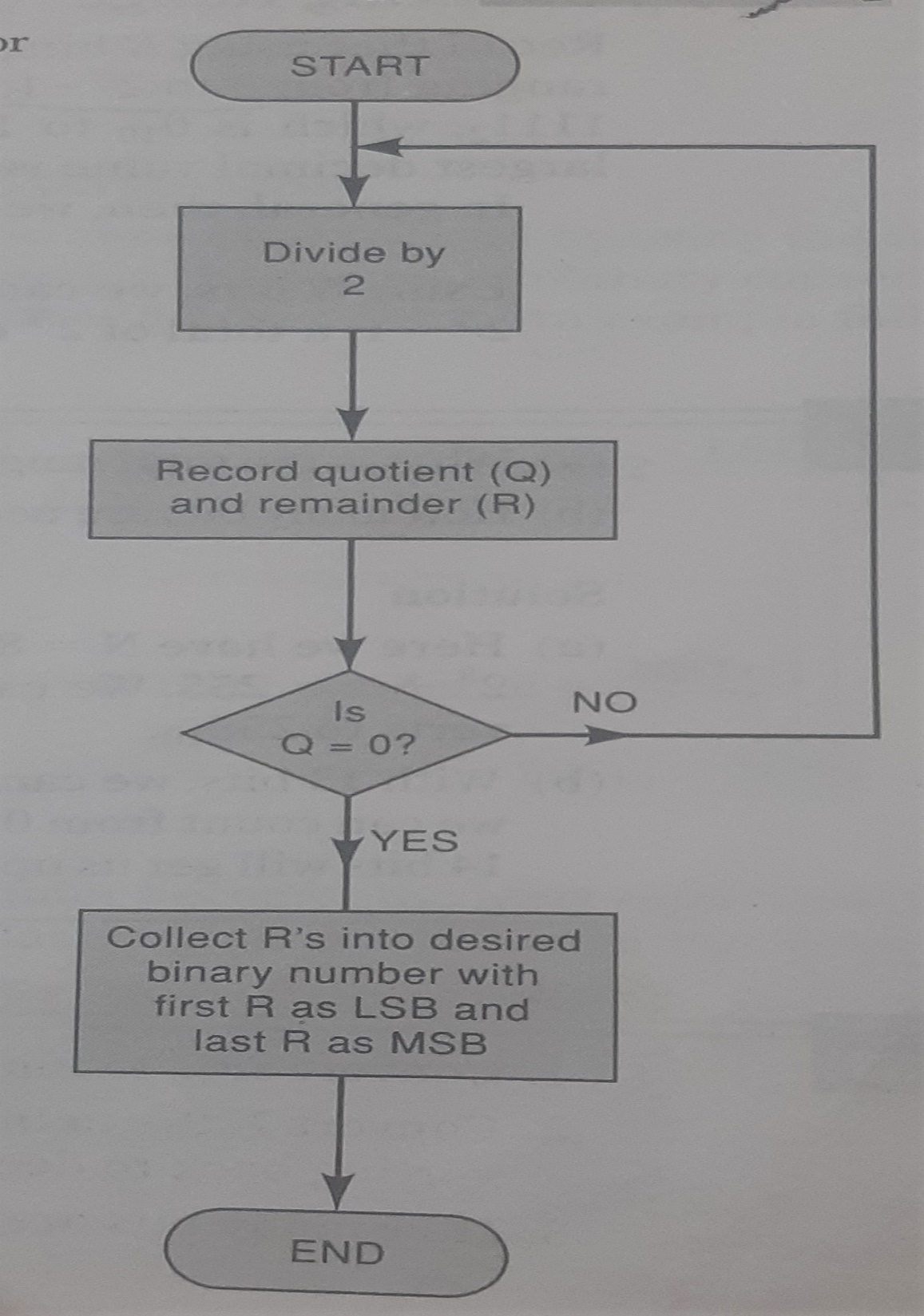
decimal to binary conversion Repeated division method

Slide 10
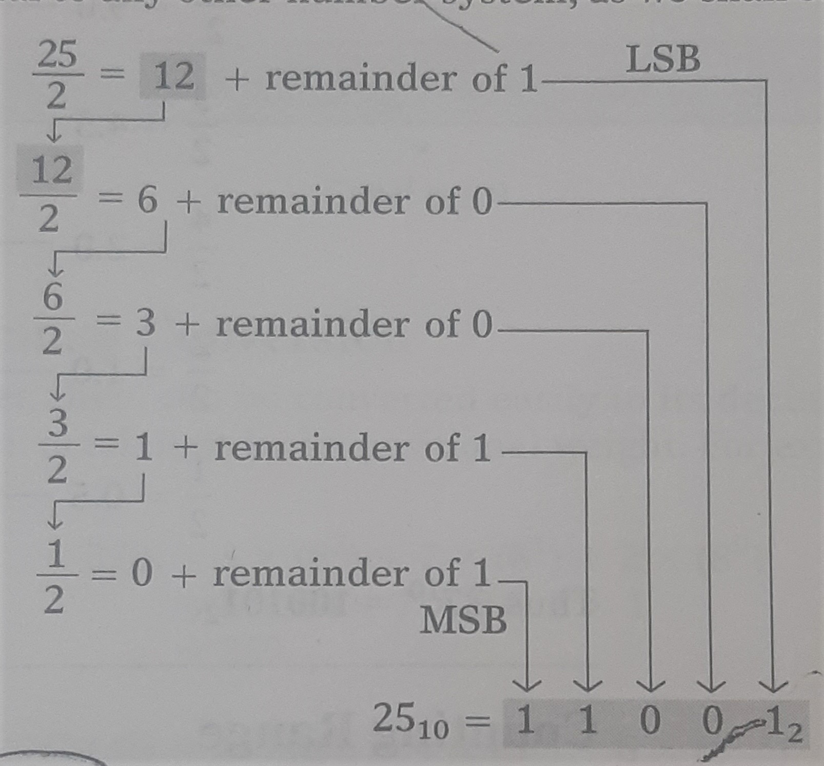
example decimal to binary conversion Repeated division method
Convert 25₁₀ to binary number.
25₁₀ = 11001₂

Slide 11
example decimal to Octal conversion Repeated division method
Convert 266₁₀ to octal number.
266₁₀ = 412₈

Slide 12
example decimal to Hex conversion Repeated division method
Convert 423₁₀ to octal number.
423₁₀ = 1A7₁₆

Slide 13
Mixed conversion

Slide 14
example octal to binary conversion
0 | 1 | 2 | 3 | 4 | 5 | 6 | 7
000 | 001 | 010 | 011 | 100 | 101 | 110 | 111
Convert 472₈ to binary number.
472₈ = 100111010₂
And
Convert 100111010₂ to octal number.
100111010₂= 472₈

Slide 15
example Hex to binary conversion
Convert 9F2₁₆ to binary number.
9F2₁₆ = 100111110010₂
And
Convert 100111110010₂ to hex number.
100111110010₂= 9F2₁₆

Slide 16
CODE

Slide 17
CODE
When number, letters or words are represented by a special group of symbols , we say they are being encoded and the group of symbols is called a code. Example: Morse code

Slide 18
BCD CODE
Each digit of decimal number is represented by its binary equivalent- called binary coded decimal code.
874₁₀
= 1000 0111 0100_{BCD}
BCD code doesn’t use A-F numbers.

Slide 19
BCD vs binary
137₁₀
= 10001001₂
= 0001 0011 0111_{BCD}

Slide 20
GRAY code
Only one bit ever changes between two successive numbers in the sequence.

Slide 21
Binary-gray conversion
B2 | B1 | B0 | G2 | G1 | G0
0 | 0 | 0 | 0 | 0 | 0
0 | 0 | 1 | 0 | 0 | 1
0 | 1 | 0 | 0 | 1 | 1
0 | 1 | 1 | 0 | 1 | 0
1 | 0 | 0 | 1 | 1 | 0
1 | 0 | 1 | 1 | 1 | 1
1 | 1 | 0 | 1 | 0 | 1
1 | 1 | 1 | 1 | 0 | 0

Slide 22
GRAY-binary conversion
G2 | G1 | G0 | B2 | B1 | B0
0 | 0 | 0 | 0 | 0 | 0
0 | 0 | 1 | 0 | 0 | 1
0 | 1 | 1 | 0 | 1 | 0
0 | 1 | 0 | 0 | 1 | 1
1 | 1 | 0 | 1 | 0 | 0
1 | 1 | 1 | 1 | 0 | 1
1 | 0 | 1 | 1 | 1 | 0
1 | 0 | 0 | 1 | 1 | 1

Slide 23
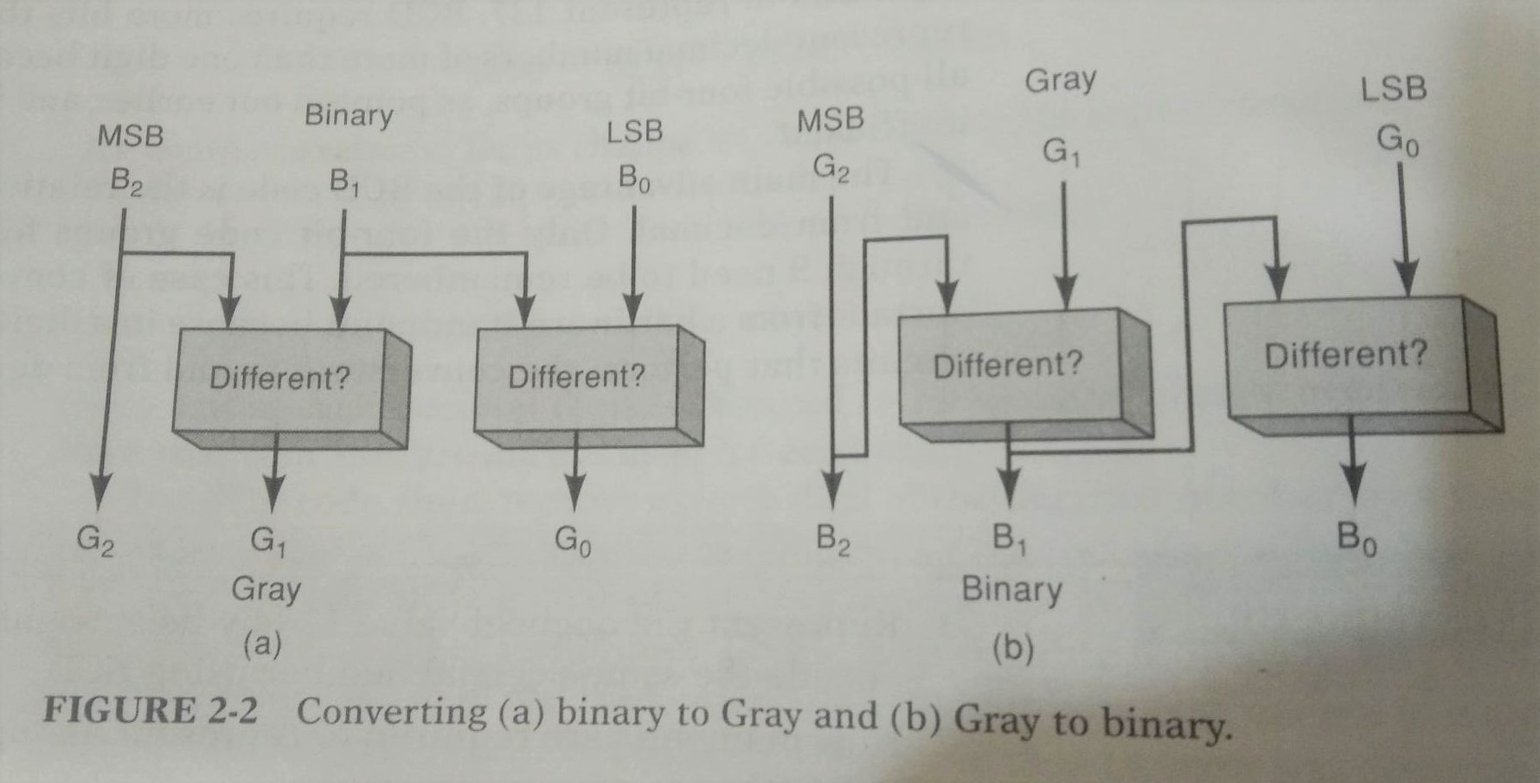
GRAY code

Slide 24
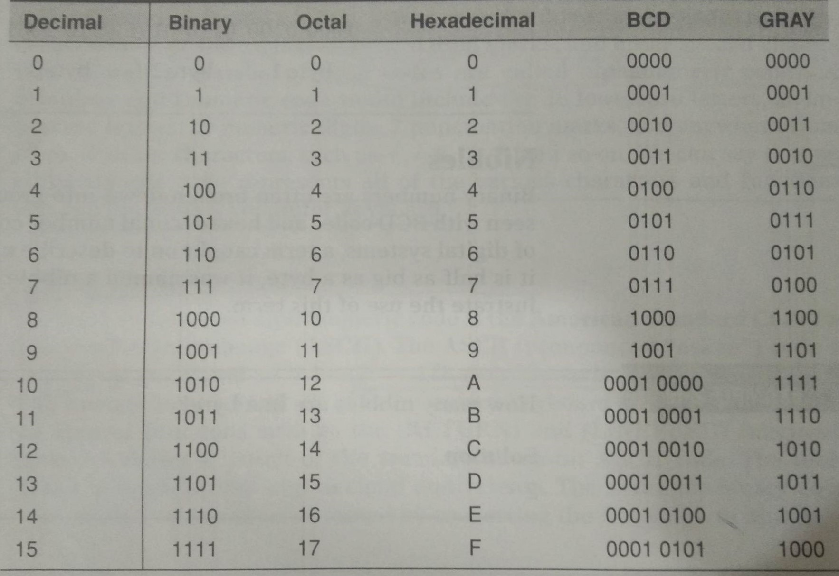
At a glance

